Slide 1
DEMAND FORECASTING
Forecasting, in general, refers to knowing or measuring the status or nature of an event or variable before it occurs. Forecasting of demand is the art and science of predicting the probable demand for a product or a service at some future date on the basis of certain past behaviour patterns of some related events and the prevailing trends in the present.
Demand forecasting is no simple guessing, but it refers to estimating demand scientifically and objectively on the basis of certain facts and events relevant to forecasting

Slide 2
Usefulness
Forecasting of demand plays a vital role in the process of planning and decision-making, whether at the national level or at the level of a firm.
offer information for budgetary planning and cost control in functional areas of finance and accounting.
help in efficient production planning, process selection, capacity planning, facility layout and inventory management.
A firm can plan production scheduling well in advance and obtain all necessary resources for production such as inputs, and finances..

Slide 3
Capital investments can be aligned to demand expectations and this will check the possibility of overproduction and underproduction, excess of unused capacity and idle resources.
Marketing relies on sales forecasting in making key decisions.
Demand forecasts also provide the necessary information for formulation of suitable pricing and advertisement strategies

Slide 4
Types of forecasts
Macro-level forecasting deals with the general economic environment prevailing in the economy as measured by the Index of Industrial Production (IIP), national income and general level of employment, money supply, inflation rates, interest rates, etc.
(i) Industry- level forecasting is concerned with the demand for the industry’s products as a whole. For example, demand for cement in India.
(ii) Firm- level forecasting refers to forecasting the demand for a particular firm’s products or services, say, the demand for ACC cement.

Slide 5
(2) Based on time period, demand forecasts may be short-term demand forecasting and long-term demand forecasting.
(i) Short-term demand forecasting covers a short span of time, depending of the nature of industry. It is done usually for six months or less than one year and is generally useful in tactical decisions. Ex Material Requirement Planning (MRP), scheduling, sequencing, budgeting etc.
(ii) Long-term forecasts are for longer periods of time, say two to five years and more. It provides information for major strategic decisions of the firm such as expansion of plant capacity, . product diversification, sales and advertisement.

Slide 6
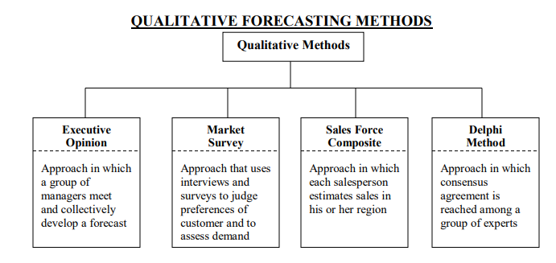

Slide 7
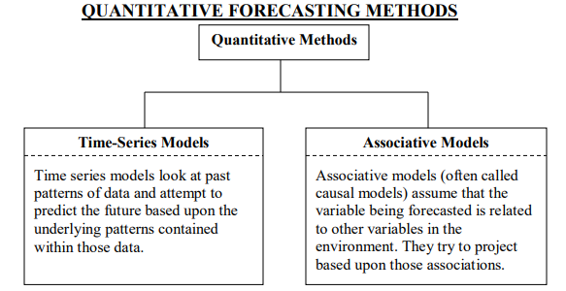

Slide 8
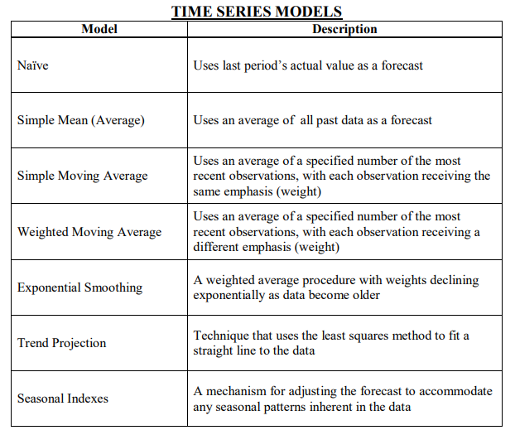

Slide 9
DECOMPOSITION OF A TIME SERIES
Patterns that may be present in a time series
Trend: Data exhibit a steady growth or decline over time.
Seasonality: Data exhibit upward and downward swings in a short to intermediate time frame (most notably during a year).
Cycles: Data exhibit upward and downward swings in over a very long time frame.
Random variations: Erratic and unpredictable variation in the data over time with no discernable pattern.

Slide 10
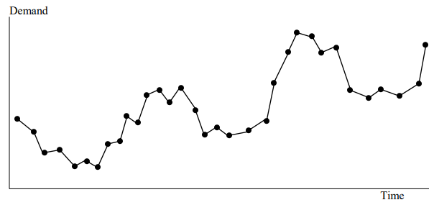
ILLUSTRATION OF TIME SERIES DECOMPOSITION
Hypothetical Pattern of Historical Demand

Slide 11
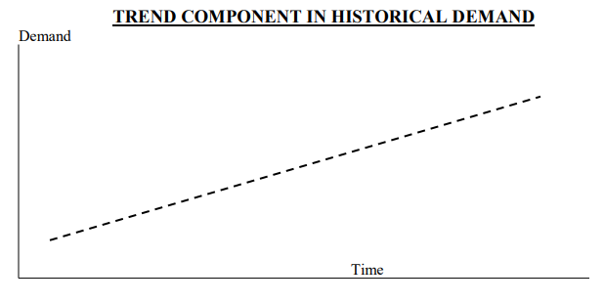

Slide 12
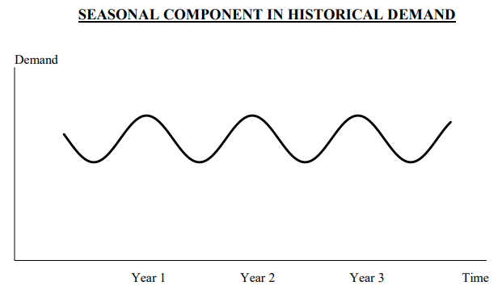

Slide 13
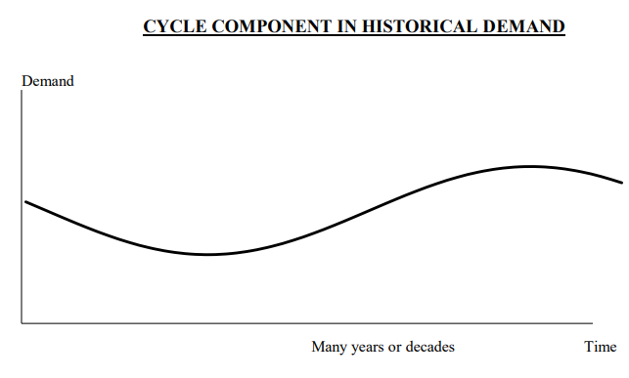

Slide 14
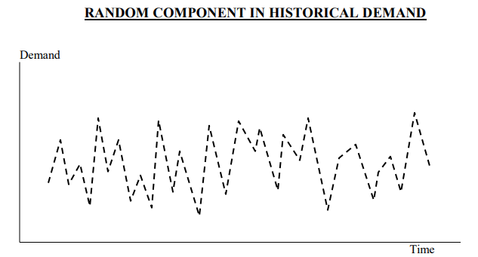

Slide 15
ILLUSTRATION OF THE NAÏVE METHOD
Naïve method: The forecast for next period (period t+1) will be equal to this period's actual demand (At). In this illustration we assume that each year (beginning with year 2) we made a forecast, then waited to see what demand unfolded during the year. We then made a forecast for the subsequent year, and so on right through to the forecast for year 7.

Slide 16
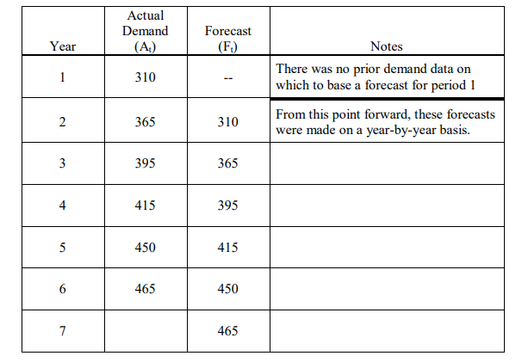

Slide 17
MEAN (SIMPLE AVERAGE) METHOD
Mean (simple average) method: The forecast for next period (period t+1) will be equal to the average of all past historical demands. In this illustration we assume that a simple average method is being used. We will also assume that, in the absence of data at startup, we made a guess for the year 1 forecast (300). At the end of year 1 we could start using this forecasting method. In this illustration we assume that each year (beginning with year 2) we made a forecast, then waited to see what demand unfolded during the year. We then made a forecast for the subsequent year, and so on right through to the forecast for year 7.

Slide 18
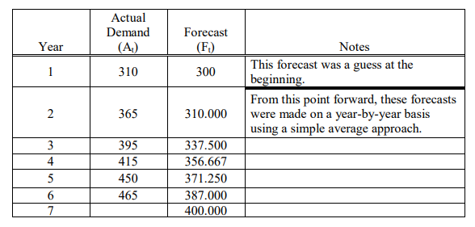

Slide 19
SIMPLE MOVING AVERAGE METHOD
Simple moving average method: The forecast for next period (period t+1) will be equal to the average of a specified number of the most recent observations, with each observation receiving the same emphasis (weight). In this illustration we assume that a 2-year simple moving average is being used. We will also assume that, in the absence of data at startup, we made a guess for the year 1 forecast (300). Then, after year 1 elapsed, we made a forecast for year 2 using a naïve method (310). Beyond that point we had sufficient data to let our 2-year simple moving average forecasts unfold throughout the years.

Slide 20
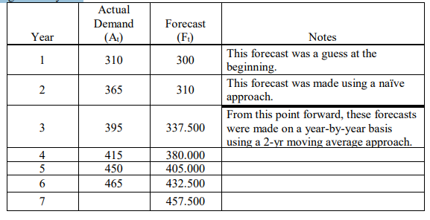

Slide 21
ANOTHER SIMPLE MOVING AVERAGE ILLUSTRATION
In this illustration we assume that a 3-year simple moving average is being used. We will also assume that, in the absence of data at startup, we made a guess for the year 1 forecast (300). Then, after year 1 elapsed, we used a naïve method to make a forecast for year 2 (310) and year 3 (365). Beyond that point we had sufficient data to let our 3-year simple moving average forecasts unfold throughout the years.

Slide 22
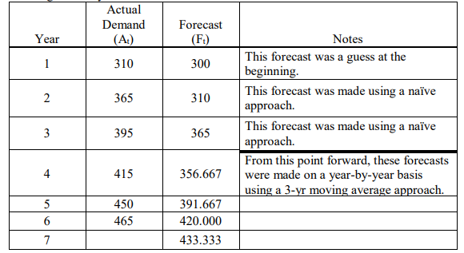

Slide 23
WEIGHTED MOVING AVERAGE METHOD
Weighted moving average method: The forecast for next period (period t+1) will be equal to a weighted average of a specified number of the most recent observations. In this illustration we assume that a 3-year weighted moving average is being used. We will also assume that, in the absence of data at startup, we made a guess for the year 1 forecast (300). Then, after year 1 elapsed, we used a naïve method to make a forecast for year 2 (310) and year 3 (365). Beyond that point we had sufficient data to let our 3-year weighted moving average forecasts unfold throughout the years. The weights that were to be used are as follows: Most recent year, .5; year prior to that, .3; year prior to that, .2

Slide 24
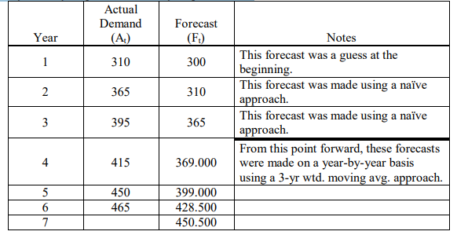

Slide 25
EXPONENTIAL SMOOTHING METHOD
Exponential smoothing method: The new forecast for next period (period t) will be calculated as follows:
New forecast = Last period’s forecast + α Last period’s actual demand – Last period’s forecast) (this box contains all you need to know to apply exponential smoothing)
Ft = Ft-1 + α(At-1 – Ft-1) (equation 1)
Ft = α At-1 + (1- α)Ft-1 (alternate equation 1 – a bit more user friendly)
Where α is a smoothing coefficient whose value is between 0 and 1.
The exponential smoothing method only requires that you dig up two pieces of data to apply it (the most recent actual demand and the most recent forecast).
An attractive feature of this method is that forecasts made with this model will include a portion of every piece of historical demand. Furthermore, there will be different weights placed on these historical demand values, with older data receiving lower weights.

Slide 26
EXPONENTIAL SMOOTHING ILLUSTRATION
In this illustration we assume that, in the absence of data at startup, we made a guess for the year 1 forecast (300). Then, for each subsequent year (beginning with year 2) we made a forecast using the exponential smoothing model. After the forecast was made, we waited to see what demand unfolded during the year. We then made a forecast for the subsequent year, and so on right through to the forecast for year 7.

Slide 27
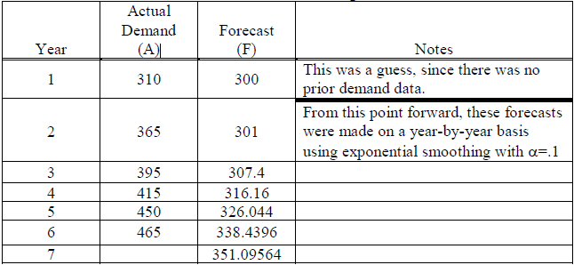
This set of forecasts was made using an  value of .1

Slide 28
A SECOND EXPONENTIAL SMOOTHING ILLUSTRATION
In this illustration we assume that, in the absence of data at startup, we made a guess for the year 1 forecast (300). Then, for each subsequent year (beginning with year 2) we made a forecast using the exponential smoothing model. After the forecast was made, we waited to see what demand unfolded during the year. We then made a forecast for the subsequent year, and so on right through to the forecast for year 7.

Slide 29
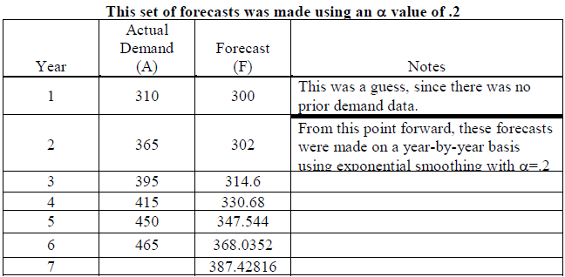

Slide 30
A THIRD EXPONENTIAL SMOOTHING ILLUSTRATION
In this illustration we assume that, in the absence of data at startup, we made a guess for the year 1 forecast (300). Then, for each subsequent year (beginning with year 2) we made a forecast using the exponential smoothing model. After the forecast was made, we waited to see what demand unfolded during the year. We then made a forecast for the subsequent year, and so on right through to the forecast for year 7.

Slide 31
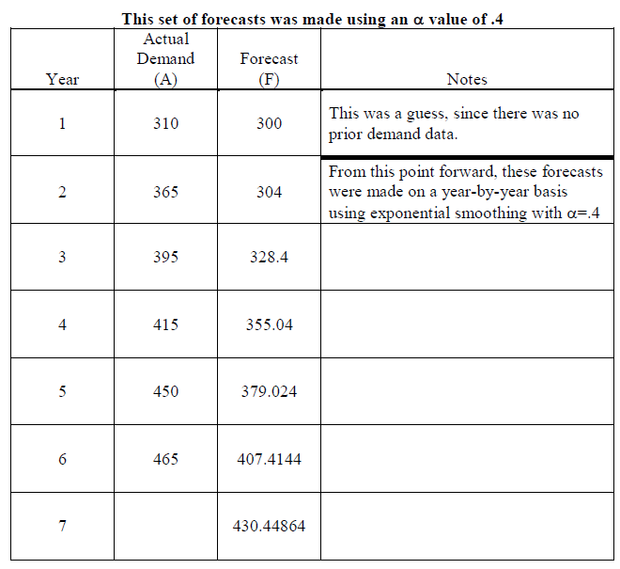

Slide 32
TREND PROJECTION
Trend projection method: This method is a version of the linear regression technique. It attempts to draw a straight line through the historical data points in a fashion that comes as close to the points as possible. (Technically, the approach attempts to reduce the vertical deviations of the points from the trend line, and does this by minimizing the squared values of the deviations of the points from the line). Ultimately, the statistical formulas compute a slope for the trend line (b) and the point where the line crosses the y-axis (a). This results in the straight line equation
Y = a + bX
Where X represents the values on the horizontal axis (time), and Y represents the values on the vertical axis (demand).

Slide 33
For the demonstration data, computations for b and a reveal the following
b = 30
a = 295
Y = 295 + 30X
This equation can be used to forecast for any year into the future. For example:
Year 7: Forecast = 295 + 30(7) = 505
Year 8: Forecast = 295 + 30(8) = 535
Year 9: Forecast = 295 + 30(9) = 565
Year 10: Forecast = 295 + 30(10) = 595

Slide 34
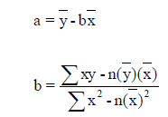
Simple Linear Regression Model
y = a + bx
where
a = intercept
b = slope of the line
x = time period
y = forecast for demand for period x

Slide 35
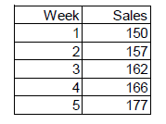
Question: Given the data below, what is the simple linear regression model that can be used to
predict sales in future weeks?

Slide 36
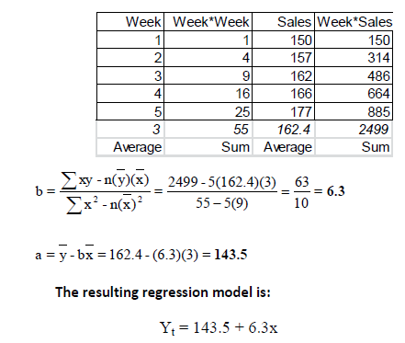
Solution: First, using the linear regression formulas, we can compute “a” and “b”.

Slide 37
Correlation Coefficient, r
✓ The quantity r, called the linear correlation coefficient, measures the strength and the direction of a linear relationship between two variables.
The linear correlation coefficient is sometimes referred to as the Pearson product moment correlation coefficient in honor
of its developer Karl Pearson.
✓ The value of r is such that -1 < r < +1. The + and – signs are used for positive linear correlations and negative linear correlations, respectively.
✓ Positive correlation: If x and y have a strong positive linear correlation, r is close to +1. An r value of exactly +1 indicates a perfect positive fit.
Positive values indicate a relationship between x and y variables such that as values for x increases, values for y also increase.

Slide 38
Negative correlation: If x and y have a strong negative linear correlation, r is close to -1. An r value of exactly -1 indicates a perfect negative fit.
Negative values indicate a relationship between x and y such that as values for x increase, values for y decrease.
✓ No correlation: If there is no linear correlation or a weak linear correlation, r is Close to 0. A value near zero means that there is a random, nonlinear relationship between the two variables
✓ Note that r is a dimensionless quantity; that is, it does not depend on the units employed.
✓ A perfect correlation of ± 1 occurs only when the data points all lie exactly on a straight line. If r = +1, the slope of this line is positive. If r = -1, the slope of this line is negative.

Slide 39
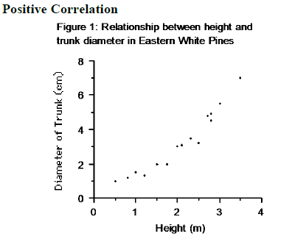

Slide 40
Notice that in this example as the heights increase, the diameters of the trunks also tend to increase.
If this were a perfect positive correlation all of the points would fall on a straight line.
The more linear the data points, the closer the relationship between the two variables.

Slide 41
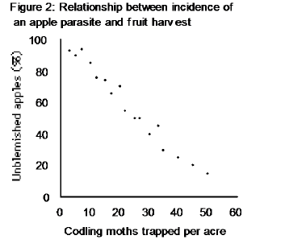
Negative Correlation

Slide 42
Notice that in this example as the number of parasites increases, the harvest of unblemished apples decreases.
If this were a perfect negative correlation all of the points would fall on a line with a negative slope.
The more linear the data points, the more negatively correlated are the two variables.

Slide 43
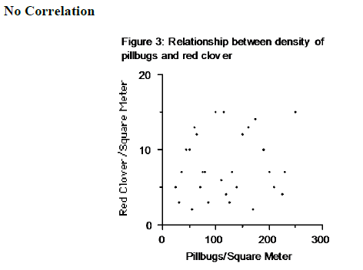

Slide 44

Notice that in this example there seems to be no relationship between the two variables.
Perhaps pillbugs and clover do not interact with one another.
The mathematical formula for computing r is:
A correlation greater than .8 is generally described as strong , whereas a correlation less than .5 is generally described as weak.

